Slide 1
Enzyme Kinetics
  Enzyme Kinetics:
  Study the rate of enzyme catalyzed reactions.
  - Models for enzyme kinetics
  - Michaelis-Menten kinetics
  - Inhibition kinetics
  - Effect of pH and Temperature

Slide 2
Enzyme Kinetics
Michaelis-Menten kinetics or saturation kinetics which was first developed by V.C.R. Henri in 1902 and developed by L. Michaelis and M.L. Menten in 1913.
This model is based on data from batch reactors with constant liquid volume.
- Initial substrate, [S0] and enzyme [E0] concentrations are known.
- An enzyme solution has a fixed number of active sites to which substrate can bind.
- At high substrate concentrations, all these sites may be occupied by substrates or the enzyme is saturated.

Slide 3
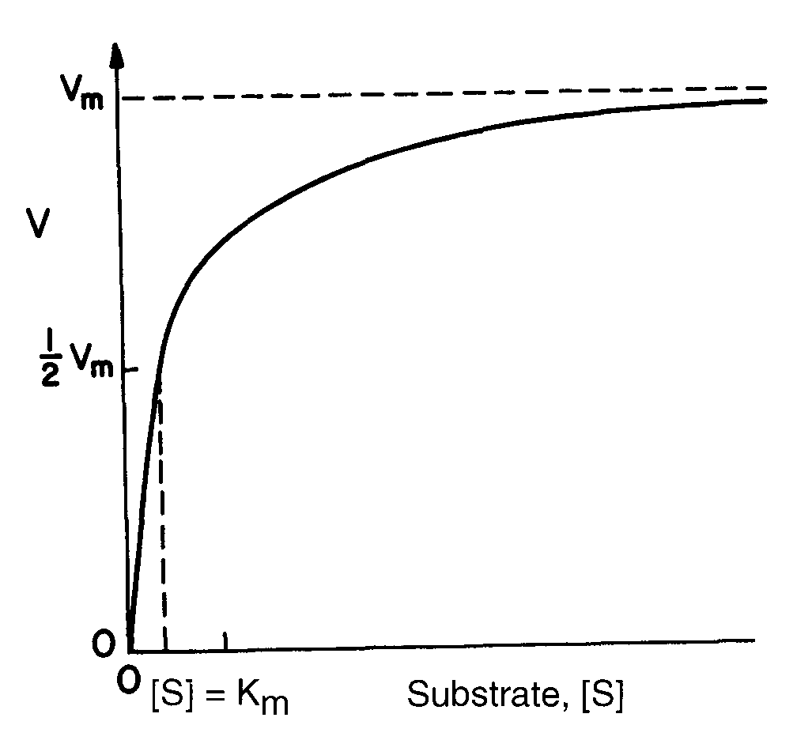
Saturation Enzyme Kinetics

Slide 4
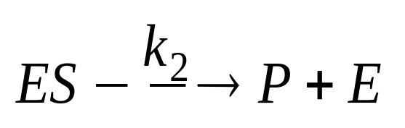
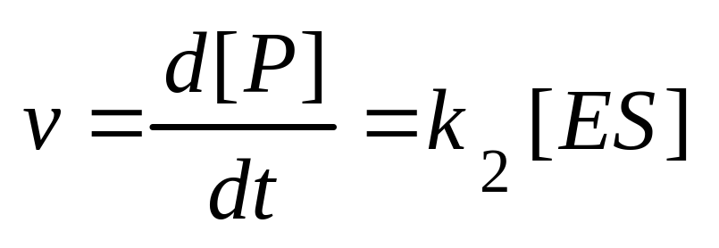
M-M Enzyme Kinetics
Saturation kinetics can be obtained from a simple reaction scheme that involves a reversible step for enzyme-substrate complex formation and a dissociation step of the ES complex.
K1
E+S
K-1
where the rate of product formation v (moles/l-s, g/l-min) is
K_{i} is the respective reaction rate constant.

Slide 5
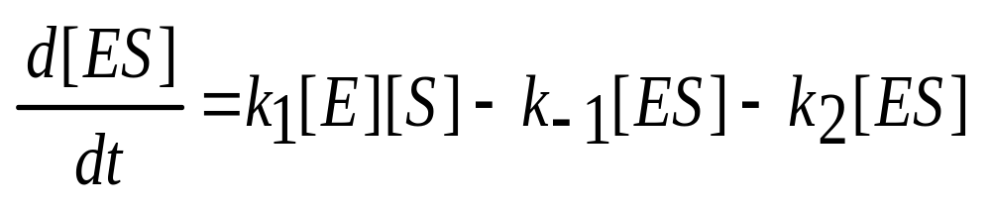
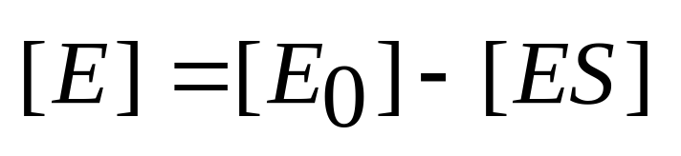
Enzyme Kinetics
The rate of variation of ES complex is
Since the enzyme is not consumed, the conservation equation on the enzyme yields

Slide 6
Enzyme Kinetics
How to use independent variable [S] to represent v?

Slide 7
Enzyme Kinetics
At this point, an assumption is required to achieve an analytical solution.
- The rapid equilibrium assumption
Michaelis - Menten Approach.
The quasi-steady-state assumption.
Briggs and Haldane Approach.

Slide 8
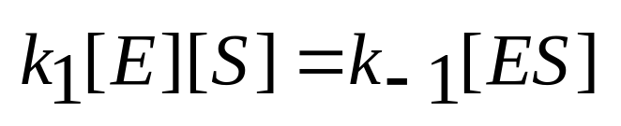
Michaelis - Menten Approach
The rapid equilibrium assumption:
Assumes a rapid equilibrium between the enzyme and substrate to form an [ES] complex.
K1
E+S
K-1

Slide 9
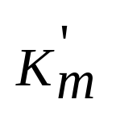
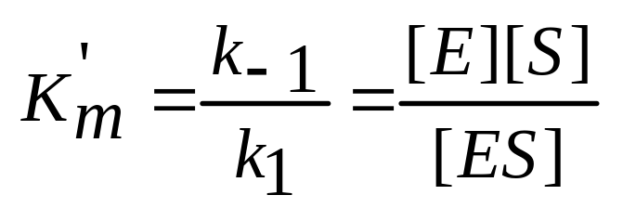
Michaelis - Menten Approach
The equilibrium constant can be expressed by the following equation in a dilute system.
K1
E+S
K-1

Slide 10
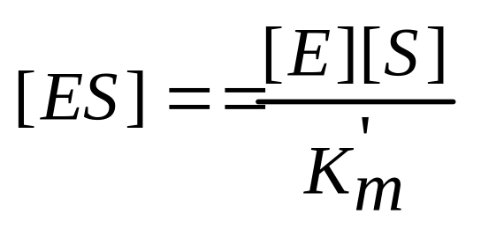
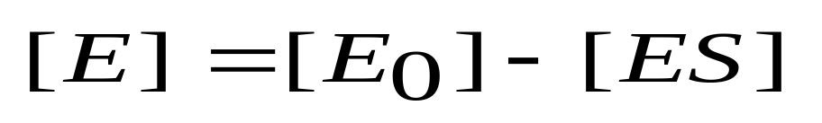
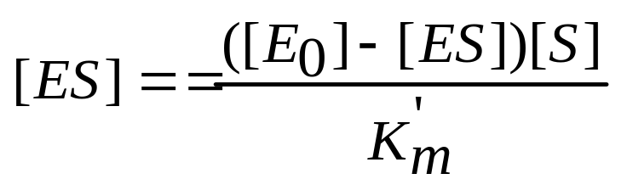
Michaelis - Menten Approach
Then rearrange the above equation,
Substituting [E] in the above equation with enzyme mass conservation equation
yields,

Slide 11
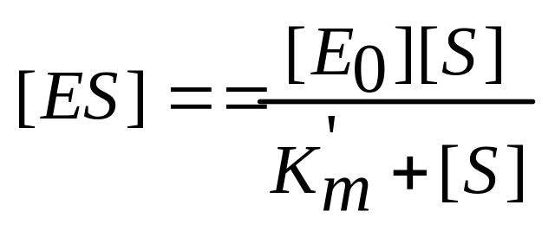
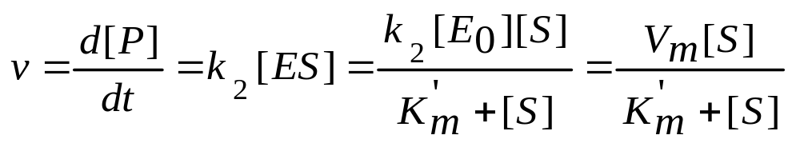
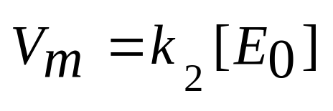
Michaelis - Menten Approach
[ES] can be expressed in terms of [S],
Then the rate of production formation v can be expressed in terms of [S],
Where
represents the maximum forward rate of reaction (e.g.moles/L-min).

Slide 12
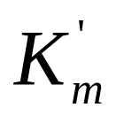
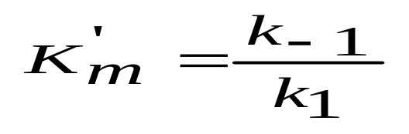
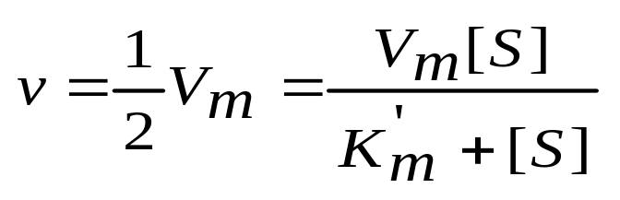
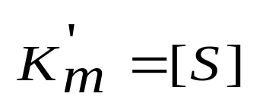
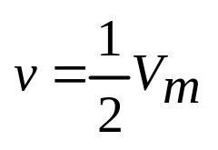
Michaelis - Menten Approach
is often called the Michaelis-Menten constant, mol/L, mg/L.
- The prime reminds us that it was derived by assuming rapid equilibrium in the step of enzyme-substrate complex formation.
Low value indicates affinity of enzyme to the substrate.
It corresponds to the substrate concentration, giving the
reaction velocity.
Re-arrange the above equation,
When

Slide 13
Michaelis - Menten Approach
Vm is maximum forward velocity (e.g.mol/L-s)
It with initial enzyme concentration.
It is determined by the rate constant k2 of the product formation and the initial enzyme concentration.
But it is by the substrate concentration.
The unit of k2 is determined by the unit of enzyme.

Slide 14
Briggs-Haldane Approach
The quasi-steady-state assumption:
A system (batch reactor) is used in which the initial substrate concentration [S₀] greatly exceeds the initial enzyme concentration [E₀].
since [E₀] was small,
d[ES]/dt ≈ 0
- It is shown that in a closed system the quasi-steady-state hypothesis is valid after a brief transient if [S0]>> [E0].

Slide 15
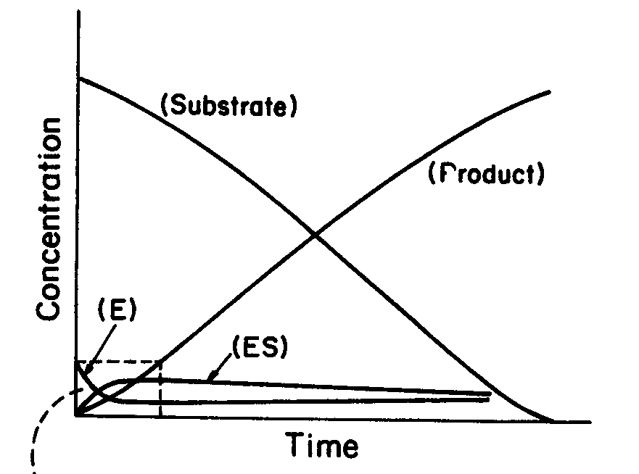
The quasi-steady-state hypothesis is valid after a
brief transient in a batch system if [S0]>> [E0].

Slide 16
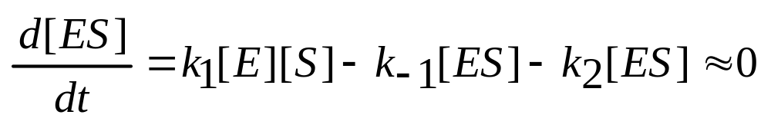
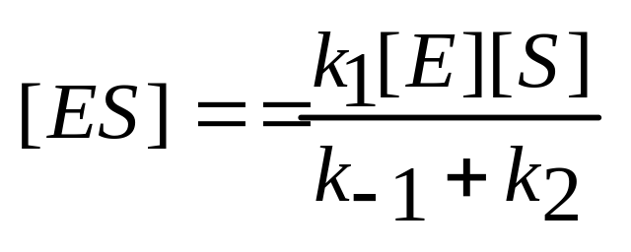
Briggs-Haldane Approach
With such assumption, the equation representing the
accumulation of [ES] becomes
Solving this algebraic equation yields

Slide 17
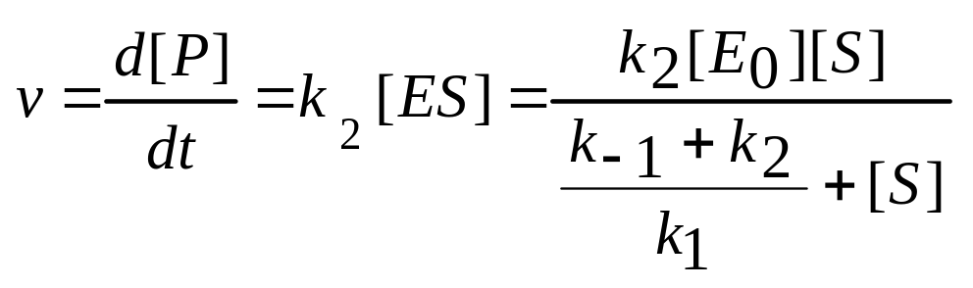
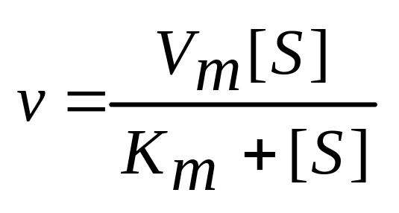
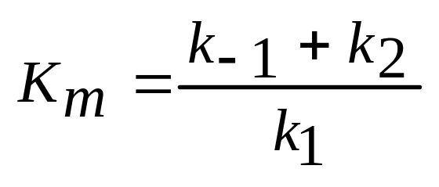
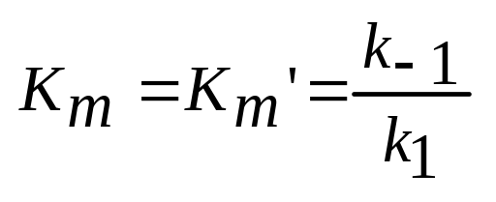
Briggs-Haldane Approach
Then the product formation rate becomes
Then,
Where
same as that for rapid equilibrium assumption.
when K2 << k-1,

Slide 18
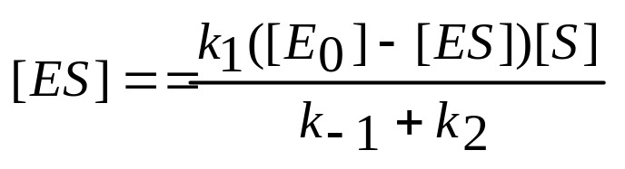
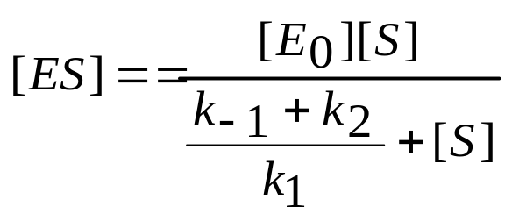
Briggs-Haldane Approach
Substituting the enzyme mass conservation equation
in the above equation yields
Using [S] to represent [ES] yields

Slide 19
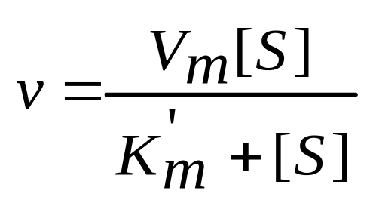
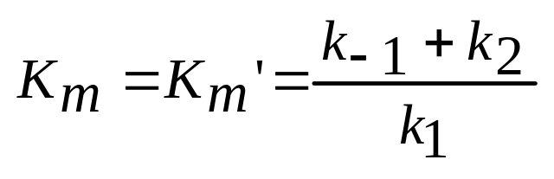
Comparison of the Two Approaches
Michaelis-Menten
Briggs-Haldane
Assumption:
d[ES]/dt ≈ 0
Equation:
Maximum forward
reaction rate:
Constant:
when k2 << k-1,

Slide 20
Experimentally Determining Rate Parameters for
Michaelis-Menten Type Kinetics.
To determine the rate parameters:
- Predict a specific enzyme catalysis system.
- Design bioreactor

Slide 21
The determination of Vm and Km are typically obtained from initial-rate experiments.
-A batch reactor is charged with known initial concentration of substrate [So] and enzyme [Eo] at specific conditions such as T, pH, and Ionic Strength.
The product or substrate concentration is plotted against time.
- The initial slope of this curve is estimated.
v=(d[P]/dt) , or = - (d[S]/dt) .
This value v depends on the values of [E0] and [S0].
- Many such experiments can be used to generate many pairs of V and [S] data, these data can be plotted as v-[S].

Slide 23
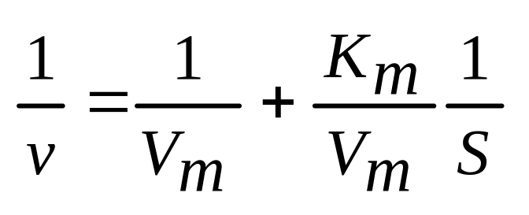
Lineweaver-Burk Plot (Double-Reciprocal Plot)
Linearizing it in double-reciprocal form:

Slide 24
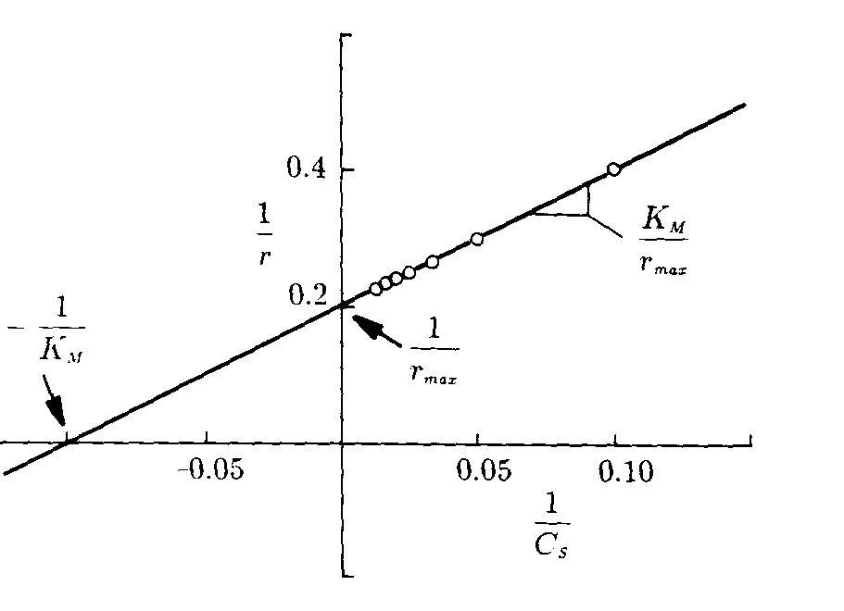
- Lineweaver-Burk plot (Double-reciprocal plot).
- a slope equals to Km/Vm
y-intercept is 1/Vm.
More often used as it shows the independent variable [S]
and dependent variable v.
-1/v approaches infinity as [S] decreases
- gives undue weight to inaccurate measurement
made at low concentration
- give insufficient weight to more accurate
measurements at high concentration.

Slide 25
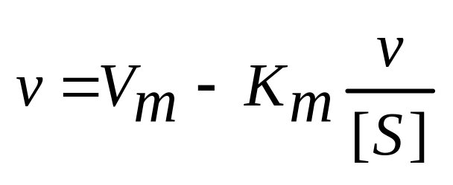
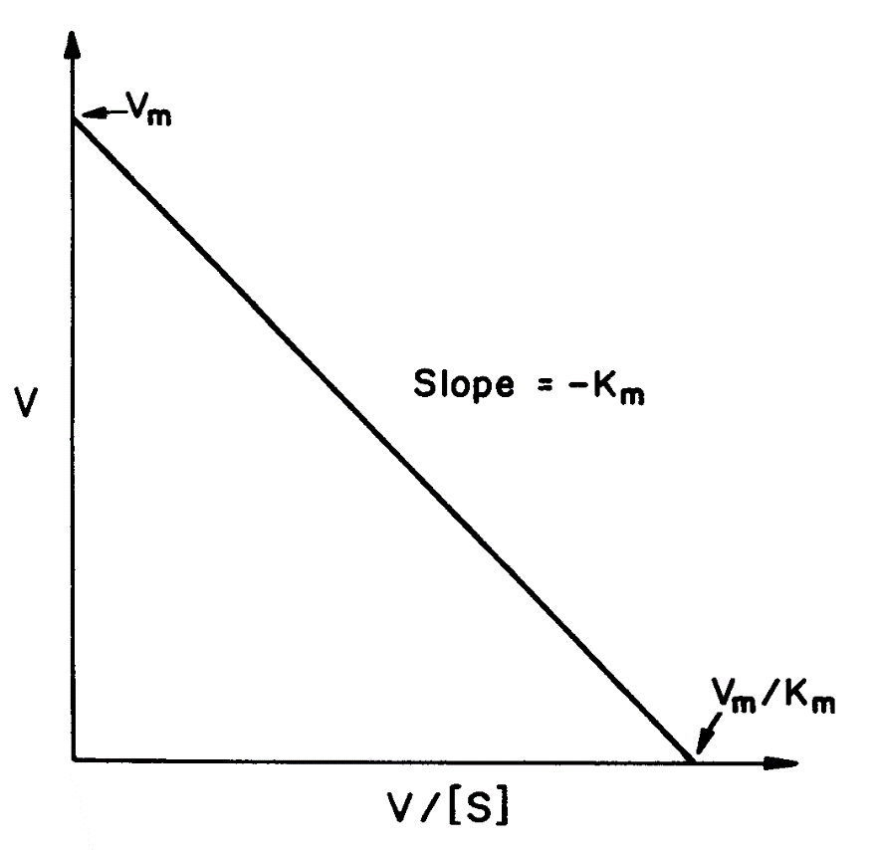
Eadie-Hofstee Plot
- the slope is –Km
- y-axis intercept is Vm.
Can be subject to large error since both coordinates contain
dependent variable v,
but there is less bias on points at low [s].

Slide 26
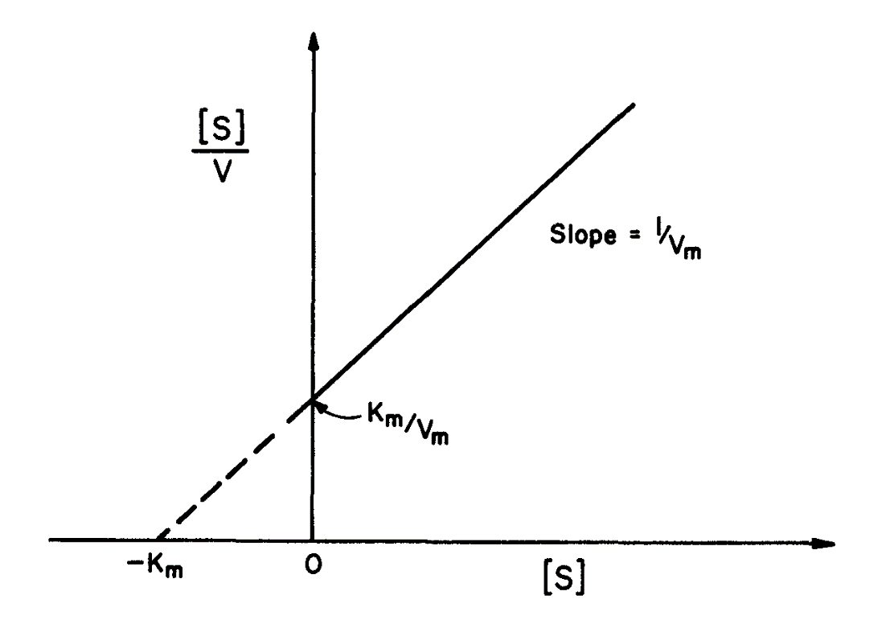
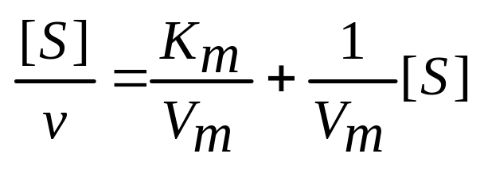
Hanes-Woolf (Langmuir) Plot
- the slope is –1/Vm
y-axis intercept is Km/Vm
better fit: even weighting of the data

Slide 27
Vm
The unit of Vm is the same as that of a reaction rate
(moles/l-min, g/l-s)
The dimension of K2 must reflect the units of [E0]
-if the enzyme is highly purified, it may be possible to express [E0] in mol/l, g/l, then K2 in 1/time.
- if the enzyme is crude, its concentration is in units.
A “unit” is the amount of enzyme that gives a predetermined amount of catalytic activity under specific conditions.
(Textbook, Bioprocessing Engineering, M. Shuler, p.66-67)
If Vm is mmol/ml-min, [E0] is units/ml, then K2 should be in mmol/unit-min.

Slide 28
Enzyme Activity
Specific Activity is the number of units of activity per amount of total protein.
Ex. A crude cell lysate might have a specific activity of 0.2 units/mg or ml protein upon which purification may increase to 10 units/mg or ml protein.
One unit would be formation of one μmol product per minute at a specific pH and temperature with a substrate concentration much greater than the value of Km.

Slide 29
Summary of Simple Saturation Kinetics
Michaelis-Menten Approach
Briggs-Haldane Approach
Use experimental data to obtain parameters of Michaelis-Menten kinetics.

